Slide 1
Version Control, Git, and GitHub
Ryan M. Richard
Ames National Laboratory and Iowa State University

Slide 2
Topics
Why do we need version control (VC)?
What is the relationship among VC, Git, and GitHub?
What do all the Git/GitHub terms mean?
What is the typical Git/GitHub Workflow?

Slide 3
Why Do We Need Version Control?

Slide 4
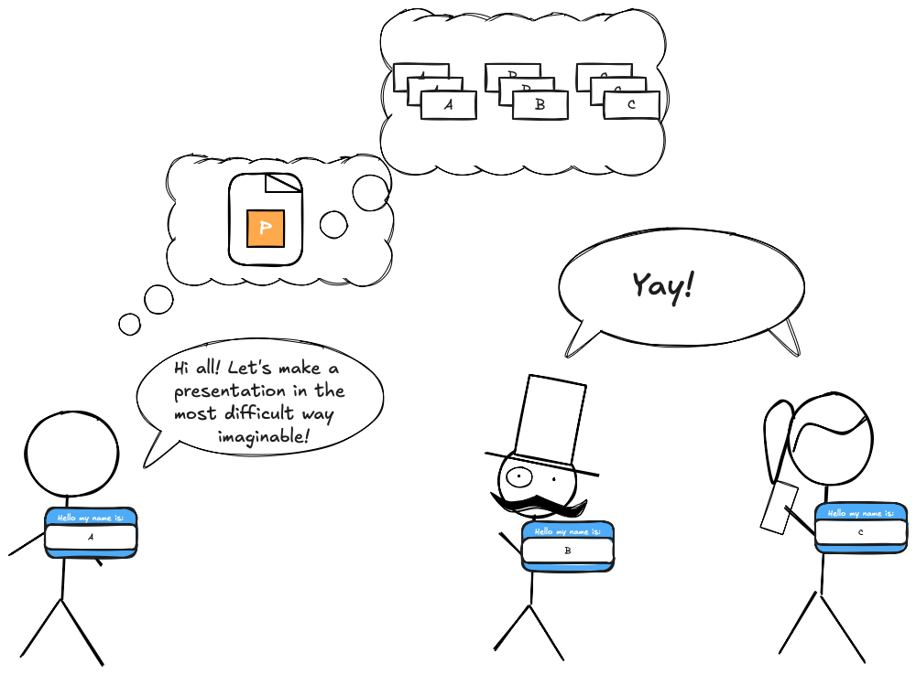
Motivation
Imagine three people are trying to write this presentation.
We’ll assume their parents were unoriginal and named them A, B, and C.
We’ll also assume these people haven’t heard of Google Slides or Office 365 and are trying to do this via email.
We’ll assume the slides are supposed to be ordered so that A’s slides come first, B’s come second, and C’s third.
Let’s work through some scenarios in which the presentation could end up coming together.

Slide 5
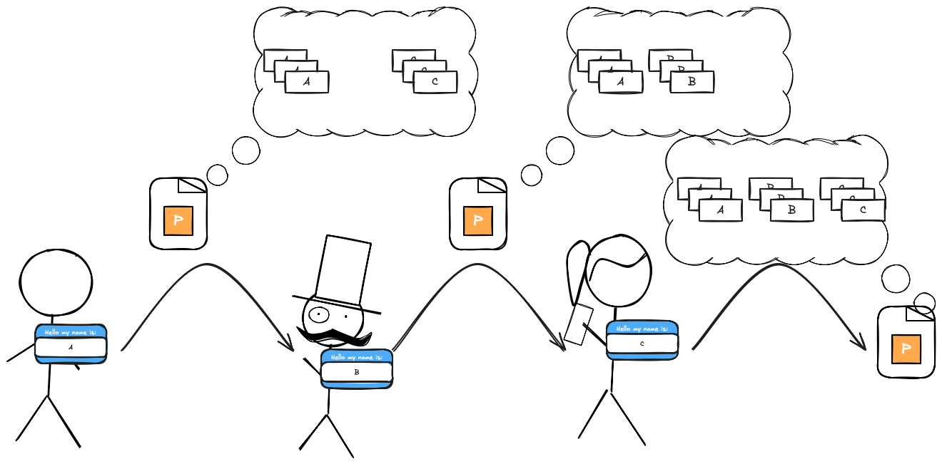
Scenario 1: Linear History (i.e., the history no time travel movie ever has)
Person A makes their slides and emails the presentation to person B.
Person B adds their slides to the presentation A sends.
Person B emails the presentation to person C.
C adds their slides.
Presentation is done.
Emailing the document works fine for this scenario.
Called a “linear history” because the timeline has no “branches.”
“Branches” are easier to define when we have one (see Scenario 2).

Slide 6
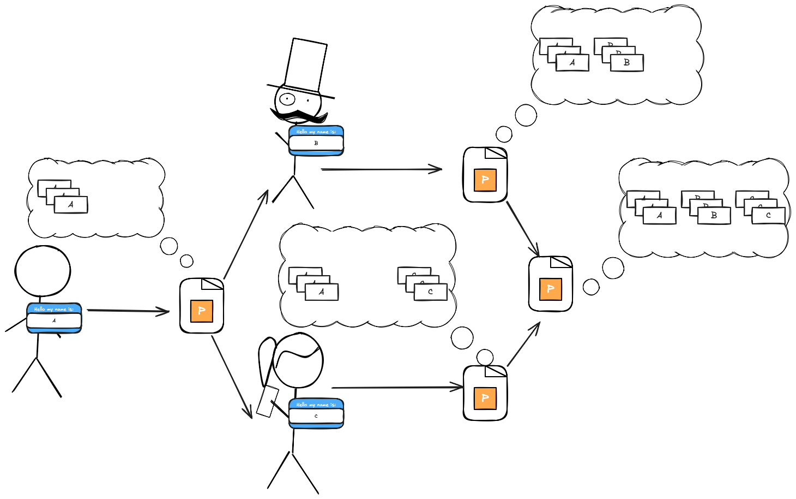
Scenario 2: Non-conflicting branched history (i.e., the timeline every time travel movie thinks it has)
Person A makes their slides.
Person A sends the slides to both B and C.
Simultaneously:
Person B adds their slides in the correct place.
Person C adds their slides in the correct place.
The two presentations are magically merged.
We get the final presentation.
Extra steps but works.
“Branched history” because different changes happen simultaneously.
Notes:
branch_no_conflict.excalidraw.png

Slide 7
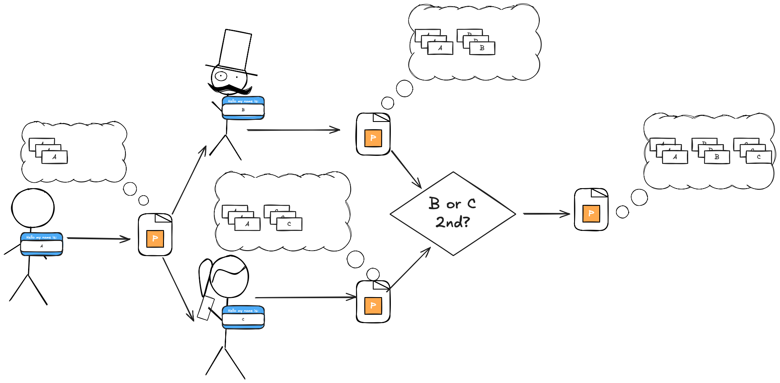
Scenario 3: The conflicting branched timeline (i.e., the timeline every time travel movie actually has)
Person A makes their slides.
Person A sends the slides to both B and C.
Simultaneously:
Person B appends their slides.
Person C appends their slides.
Problem, both B and C think their slides come directly after A.
The magic merging the presentations moves C’s slides to the end.
We get the final presentation.
Even more extra steps but works.
“Branched history” because different changes happen simultaneously.
“Conflicting” because the histories are not compatible.

Slide 8
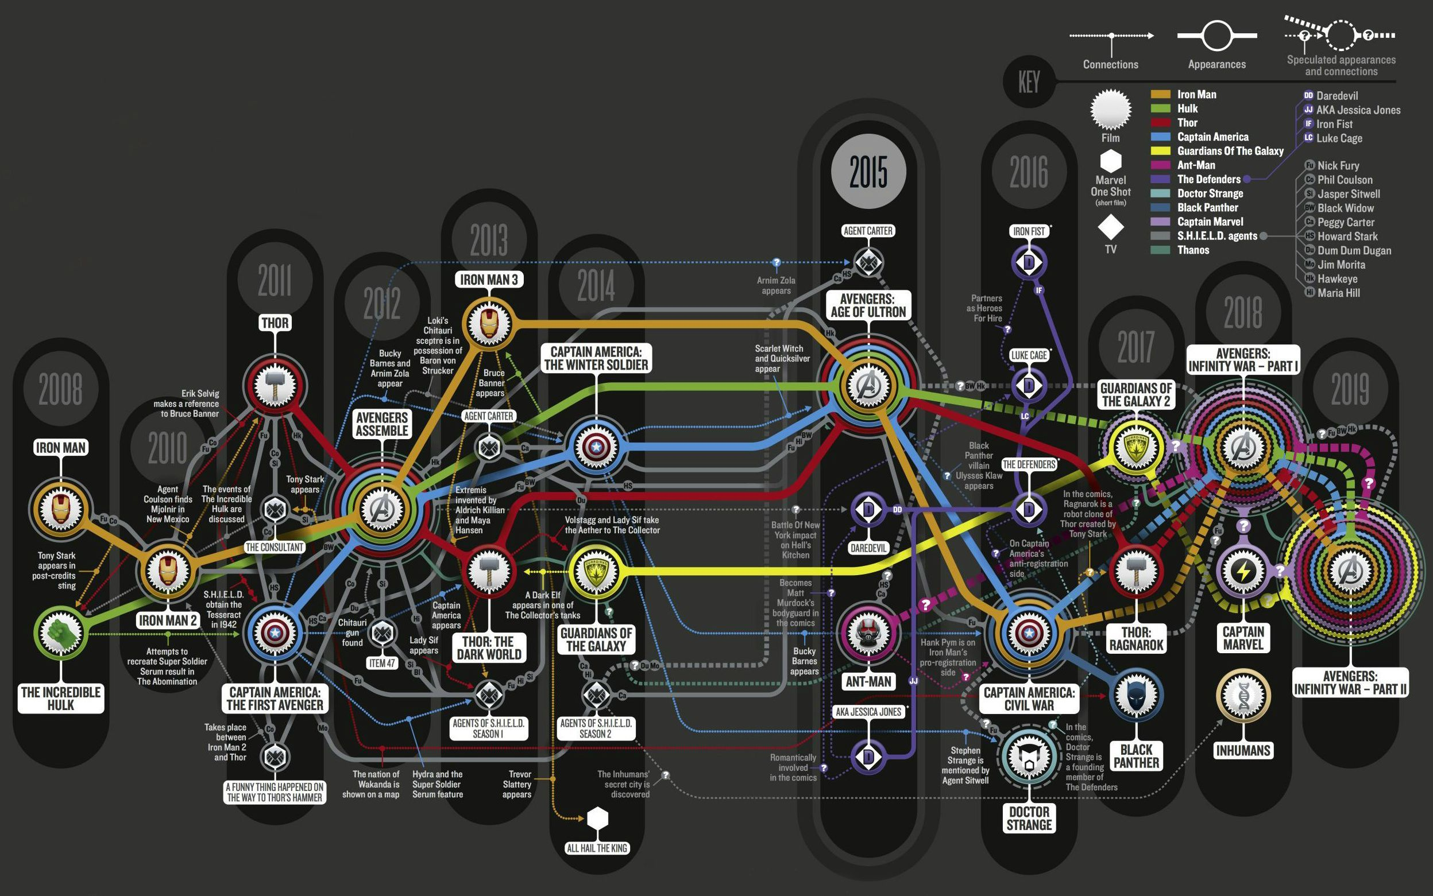
Motivation Summary
Having multiple people work on the same file can be difficult without coordination.
Guess what happens when we have multiple people work on multiple files without coordination?
Joke answer: the Avengers timeline!!!
Serious answer: same as joke answer, but with less A-list celebrities.
Modern software development almost always involves multiple people working on multiple files in an uncoordinated (or loosely coordinated) manner.

Slide 9
What is the Difference Among Version Control, Git, and GitHub?

Slide 10
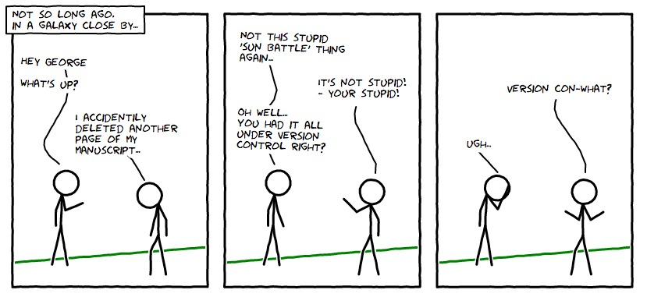
What is Version Control (VC)?
VC software is used to manage the history (i.e., versions) of a software project.
Superficially, VC gives you save/load, undo, redo for a set of files.
Automates (to the extent possible) the steps we termed “magic.”
Historically, there have been many different VC software packages.
Now, most developers (95% according to Wikipedia) have coalesced around Git.

Slide 11
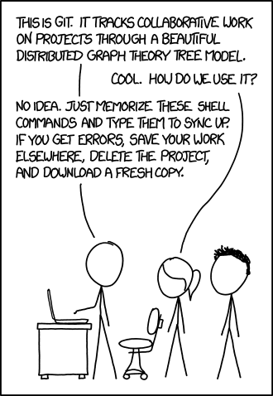
What is Git?
Developed by Linus Torvalds (creator of Linux) for version controlling the Linux kernel.
Written because Linux community lost their free license to a proprietary VC software.
Amusingly written in about two weeks and was already more performant than all other existing VC software in week three.
According to Linus Torvalds, the name’s meaning depends on your mood:
Random three-letter combination that is a mispronunciation of “get”.
“Global information tracker” if you’re in a good mood.
“Goddamn idiotic truckload of sh*t” when it breaks.
Linus joked he names all his projects after himself (“git” means unpleasant person in British English).

Slide 12
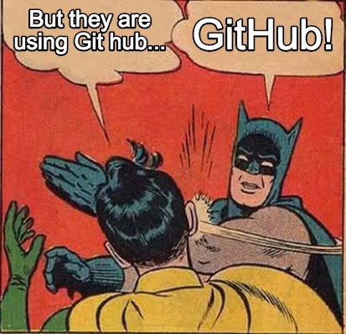
What is GitHub?
For SIMCODES we are using Git in the context of GitHub.
Git is the software responsible for VC-ing our software project.
GitHub is “just” a storage solution.
Conceptually like Google Drive or DropBox.
You use Git to interact with GitHub.
While you can also manually upload/download files this is cumbersome when you are working with multiple files.

Slide 13
Git and GitHub Terminology

Slide 14
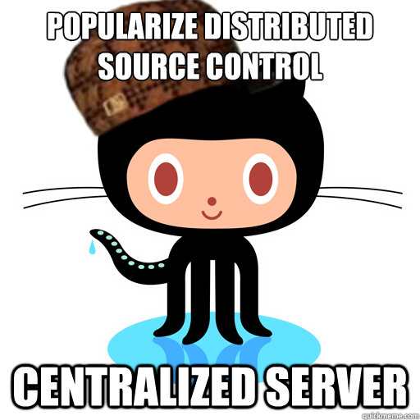
Disclaimer: Simplifications Ahead
Git is an incredibly powerful VC solution.
Git’s power comes from not assuming any “copy” of the project is special.
This requires additional levels of abstraction that complicate things.
Often one copy is actually special, kinda like the “sacred timeline”.
Usually the copy on GitHub.
We introduce concepts assuming there exists a special “copy”.
The git Jedis in the room know that there’s exceptions to pretty much everything I’m about to tell you.

Slide 15

Git Terminology: Repository
A repository is a directory containing the source files and the history of changes to those files.
A local repository is a repository that lives on the computer you are currently using.
You will develop software in a local repository.
A remote repository is a repository that lives on a different computer.
For now, ”remote” repository is synonymous with “the repository that lives on GitHub”.
Repository is usually shortened to just “repo.”

Slide 16

Git Terminology: Clone
The first step in developing software is to get a copy of the existing source code.
Usually, the repo you want to develop for already lives on GitHub.
If you are starting a brand-new repo, first create the repo on GitHub.
Then treat the newly created repo like an existing repo.
To get a local copy of a remote repo you clone it.
Unless you delete your local repo, you typically only clone a repo once.

Slide 17

Git Terminology: Branch
A branch is a (linear) history of the repo.
It’s one of the many timelines.
Usually, one branch is special.
Often called the main branch (previously master).
The special branch is the ”final” version of the project.
Other branches are sometimes called development branches.
You should always be working on a development branch.

Slide 18
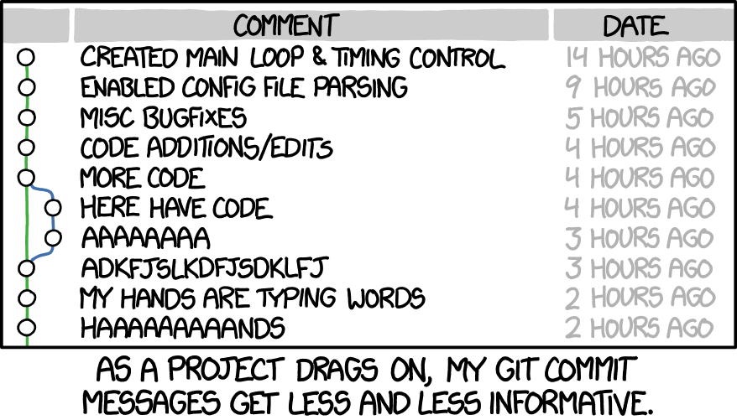
Git Terminology: Commit
Git doesn’t come with “auto-save”.
A commit is the set of changes you made to the branch since the last commit.
Conceptually, a commit is Git’s equivalent of “saving”.
In the timeline analogy, commits are events.
Commits can add content and/or remove content.
Commits save your work on the current branch. Other branches remain unchanged.

Slide 19
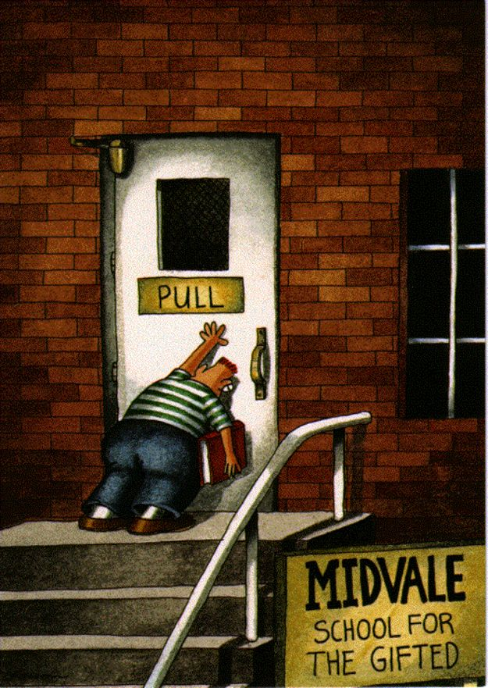
Git Terminology: Push, Pull, Merge
When you are done developing a feature locally you need to add the feature to the remote repo.
You push your changes from your local branch to the remote branch.
You pull changes from a remote branch to your local branch.
If you are moving changes from one local branch to another local branch you merge the branches.
As a note, pushing and pulling are implemented in terms of merge, so “merge” is usually used as a catchall.

Slide 20
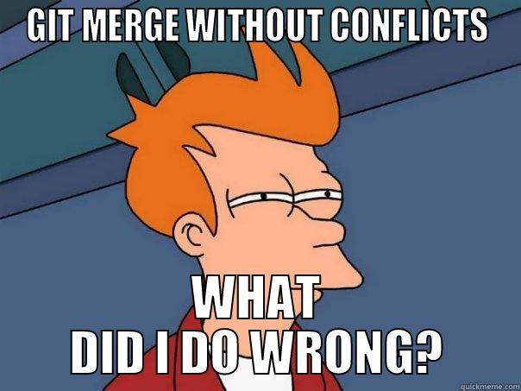
Git Terminology: Conflict
Git is pretty good about merging changes automatically.
However, when the same lines of code have been modified, Git usually needs help merging.
When Git cannot automatically merge two branches, the branches are said to be in conflict.
If a conflict occurs Git will show you the two changes and you will have to decide how to reconcile them.

Slide 21
GitHub Terminology: Organization
Developer teams usually work on a series of related projects.
E.g., the SIMCODES team has one project for the website, one project for training materials, and several projects for research.
Git provides no mechanism for grouping repositories.
We don’t speak of git submodule…
A GitHub organization allows a developer team to group their repos together.
SIMCODES has the GitHub organization SIMCODES-ISU.
SIMCODES was taken…

Slide 22

GitHub Terminology: Pull Request
A pull request (or PR for short) tells the maintainers of a GitHub repo that you want them to pull changes into their repo.
The repo owners can then decide if they want those changes or not.
Originally, PRs were needed because we didn’t want just anyone making changes to our code.
Most repos now require PRs, regardless of who is making changes.
PRs are used to automatically test changes before merging them.

Slide 23

GitHub Terminology: Fork
PRs must be between branches that live on GitHub.
Say you are trying to change the SIMCODES-ISU/training_materials repo.
If you have sufficient privileges, then create a branch and make a PR.
But what if you don’t have sufficient privileges?
A GitHub fork is a clone of a GitHub repository that you own.
Can make the PR from a branch of your fork.
Even if you have permission to create a branch in a repo, you can always fork the repo and make a PR from the fork.

Slide 24
What is a typical Git/GitHub Workflow?

Slide 25

How to get Git?
Should already have it, if not:
Windows: Open a terminal, type sudo apt-get install git
MacOS: It comes pre-installed.
This tutorial goes over the basics of Git using a terminal.
GUIs for Git are plentiful.
If you use an integrated development environment (like VSCode) Git is usually built in.
IMHO it’s good to use Git from terminal a couple times to understand what is going on. So that’s what this tutorial does.

Slide 26
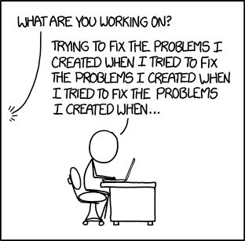
Public Service Announcement
If you follow these steps, every single time you develop software you will rarely (if ever) encounter a Git/GitHub problem.
Disclaimer: problem is not the same as “conflict”, though this workflow will greatly reduce conflicts too!
If you don’t follow these steps, you can still accomplish your goals, but you will make life 10x harder for yourself.
In my experience, 99% of Git problems come from skipping one of theses steps.

Slide 27
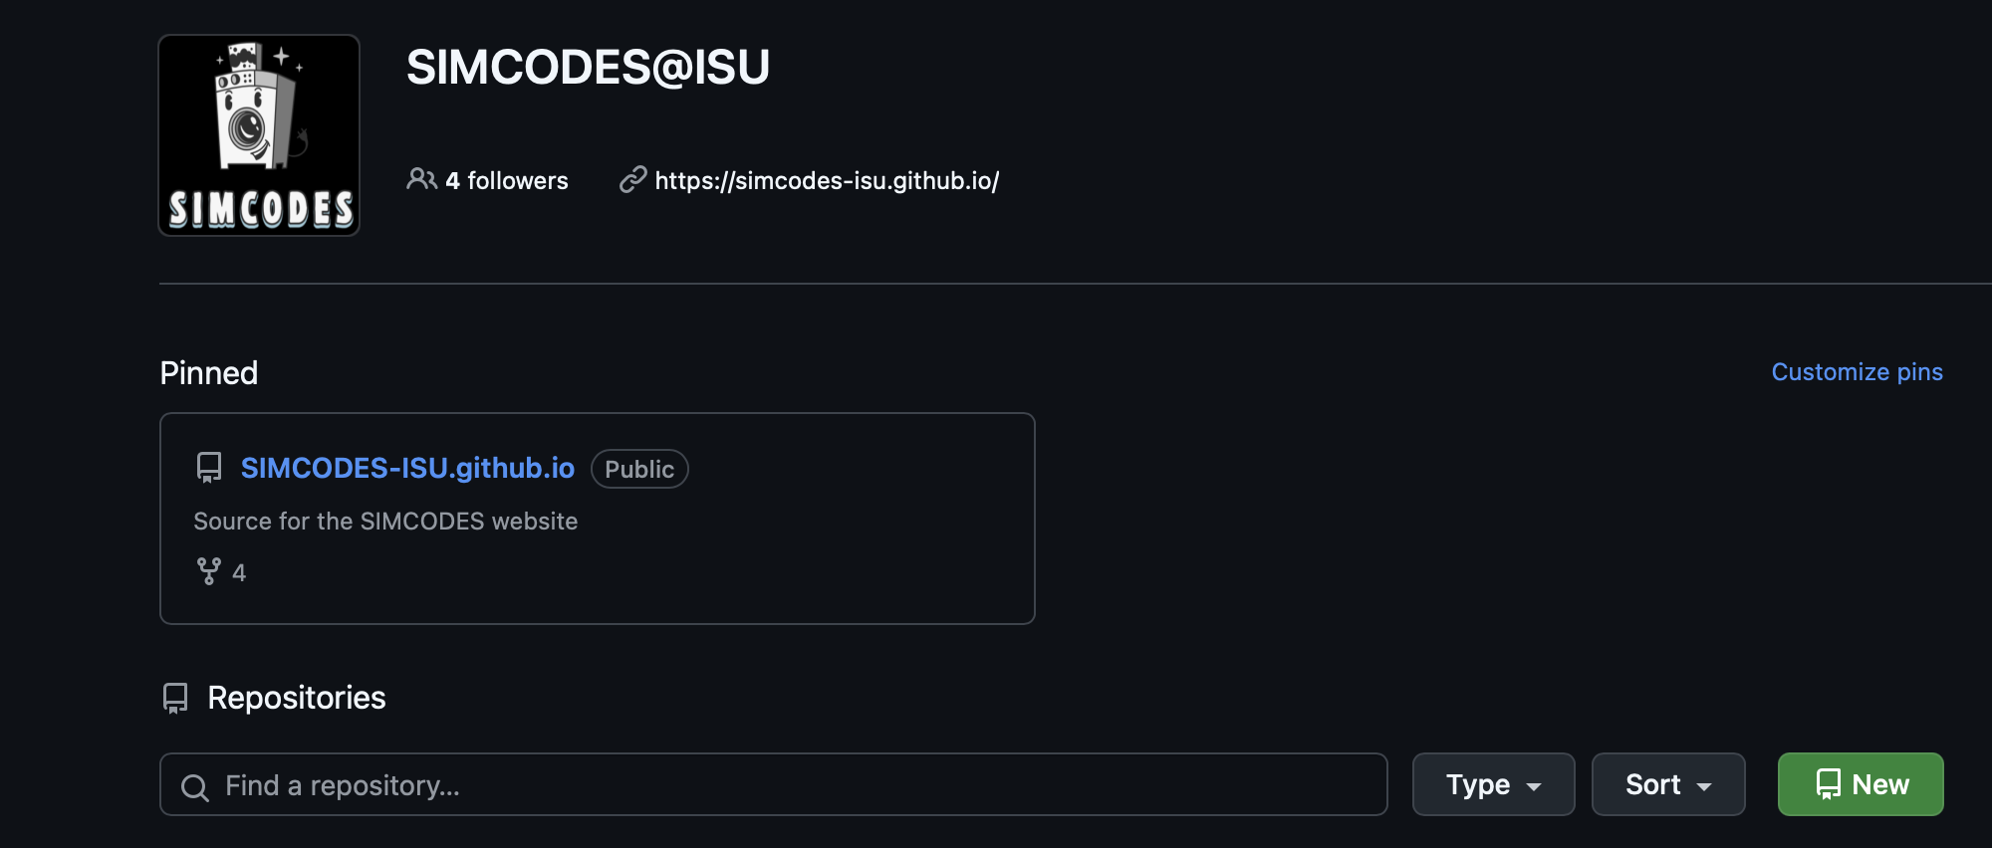
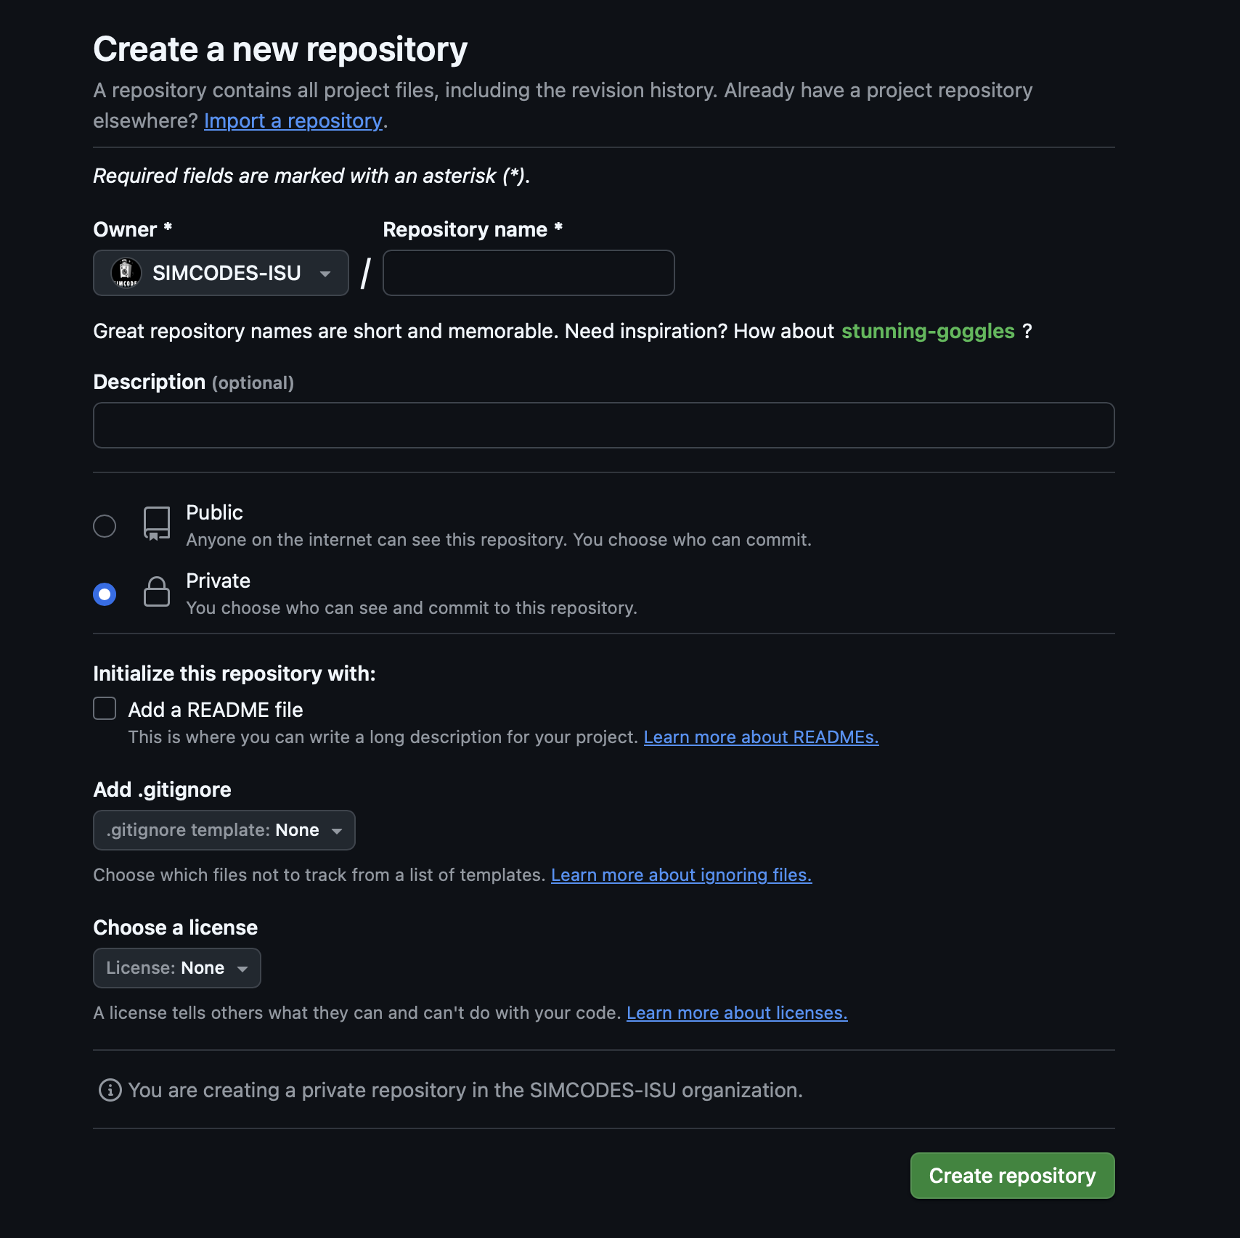
Step 0: Create the GitHub Repo
If the repo doesn’t exist yet you need to create it.
Click the green button, then fill out the fields.
For this tutorial pick:
Name the repo (you can change it later)
Select “public” repo.
Leave the rest unchecked and click “Create repository”.
Since y’all will need a repo for this summer anyways, go ahead and do that now.

Slide 28

Slight Aside: Get Cookiecutter
Setting up a software project from scratch takes a long time.
Most of the setup work is creating configuration files.
This is often called “boiler plate.”
Cookiecutter is a tool that allows you to create template software projects roject makes it easy to create a repo with default options.
MolSSI has prepared a CookieCutter project aimed at computational chemistry. We’ll use that for this tutorial.
Recommend you us a virtual environment.
python –m venv name_of_venv && source name_of_venv/bin/activate
Install Cookiecutter: pip install cookiecutter

Slide 29
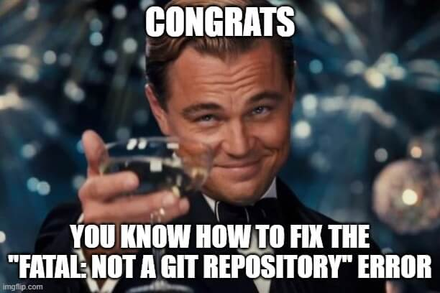
Slight Aside: Initialize a Repo
Run Cookiecutter: cookiecutter gh:molssi/cookiecutter-cms
To initialize the repo Cookiecutter will ask you some questions. Recommended answers are:
Project name: Up to you, but should probably be related to, if not the same as, the name of the GitHub project.
Repo name: whatever the repo you created on GitHub is called.
First module name: default is fine.
Author name: Mark Twain (kidding, put YOUR name)
Author email: I think you can figure this one out
Description: A SHORT phrase describing the project.
Open-source license: pick 4 (we want to use the Apache 2.0 License)
Dependency source: 3 (pip only)
Select include ReadTheDocs: n

Slide 30
Step 0: Populate the Repo
When you made a repo, GitHub should have told you how to populate it.
cd your_repo_name
git remote add origin https://github.com/SIMCODES-ISU/<your_repo_name>.git
git branch -M main
git push -u origin main
Don’t worry too much about these commands. You don’t initialize repos often and when you do, GitHub will remind you what commands to run…

Slide 31
Alternative Step 0: Get a Local Copy of an existing Repo
We just initialized the remote repo with a copy of our local repo.
Usually, the remote repo exists, and you want to initialize a local repo with a copy of the remote repo.
Pop Quiz: What was the Git term introduced for the action of getting a local copy of a repo?

Slide 32
Alternative Step 0: Clone the Repo
Answer: Clone.
If we didn’t already have the repo, we could get it by running git clone <url_of_your_repo>

Slide 33
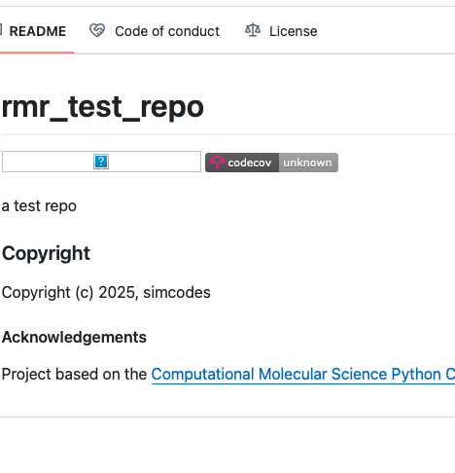
First Task: Fix the README!
If we look at our repo on GitHub we see one of the badges is broken.
Refresh the page if it still shows the commands to upload it.
Fixing the badge is easy (and a great first tutorial).
The following slides will walk you through the typical Git/GitHub workflow to fix the badge.
The usual Git/GitHub workflow starts at this point, i.e. once you have a local copy of the remote repo.

Slide 34

Step 1: Make a Feature Branch
You should NEVER make changes to the main/master branch!
Exception: None. There is no exception!
But what about if…No! Don’t do it!
In my experience, making changes directly to the main/master branch is the primary way Git newbies get in a pickle.
To make a branch: git checkout –b fix_badge
“checkout” is the git sub-command used to switch branches.
“-b” flag is used to additionally create the branch
“fix_badge” is the name of the branch.
Pro tip: git status is used to see what branch you are on (amongst other things).

Slide 35
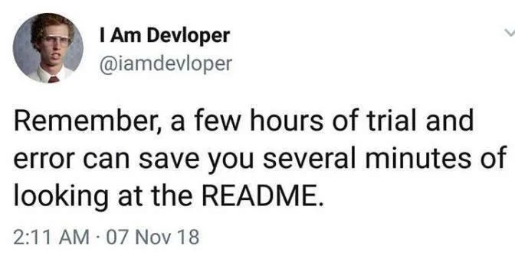
Step 2: Make Some Changes
Now open README.md with a text editor.
Replace “REPLACE_WITH_OWNER_ACCOUNT” with “SIMCODES-ISU”
Don’t forget to save the file.
Note that saving the file, saves it locally. It does NOT save it with Git.
Pop quiz: What is the term for saving a file with Git?

Slide 36
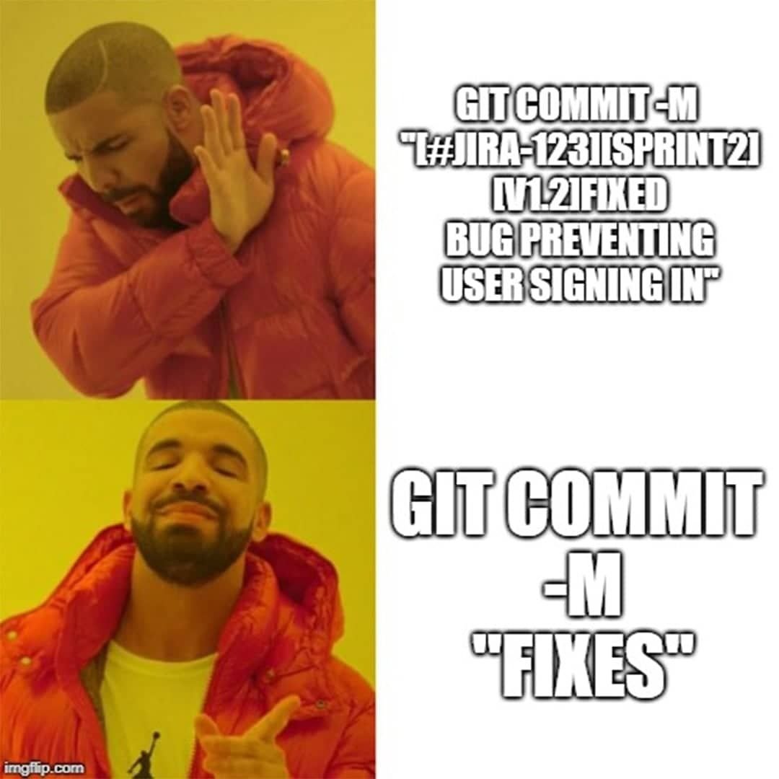
Step 3: Commit the Changes
To save the changes we made to VC, we need to commit them.
To commit: git commit –a –m “fixed badges”
“commit” is the sub-command for deleting all your files (kidding)
“-a” flag tells git commit you want to commit all the changes.
“-m” tells git commit that the next argument is your commit message.
“fixed badges” is the commit message, i.e., a very short (think like 10 words max) description of what you did.

Slide 37


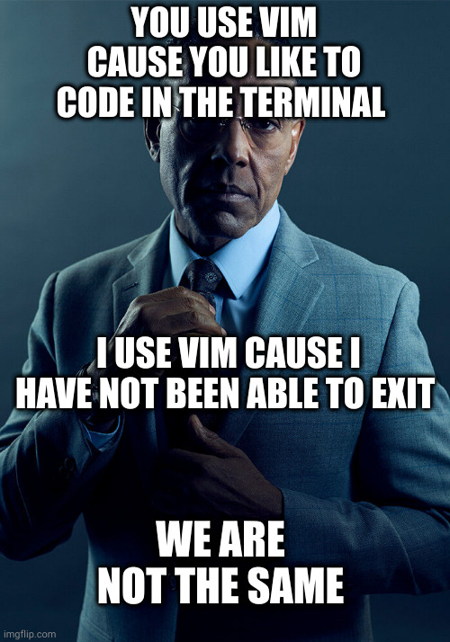

Notes on Committing
Git requires you provide a commit message with each commit.
If you leave off the “-m” flag it will open your terminal’s text editor of choice so you can write the message.
Many of these editors are highly non-intuitive.
Case and point, the default editor is most likely “vim”. If you open vim the way to close it is to type the sequence (no commas): esc, :, q, !, enter.
I won’t even begin to explain to you how to type text in vim…
Our example assumed you wanted to commit all changes. Sometimes that’s not the case.
git add <name_of_file1> <name_of_file2> …
Then run git commit without the “–a” flag.

Slide 38
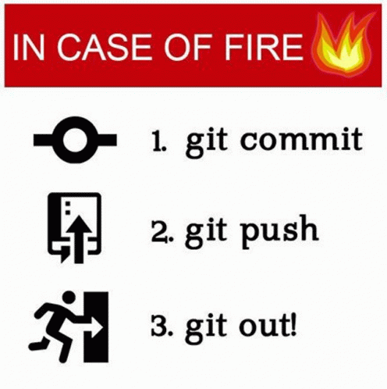
Step 4: Push the Changes
Now the changes are saved locally, but not remotely.
To push the changes: git push origin fix_badge
“push” is the git sub-command for (you can figure this out).
“origin” is the name given to the remote repo (so you don’t have to type out the URL).
“fix_badge” is the name of the branch on the remote repo.
Will generally be the same as the name of your local branch.

Slide 39
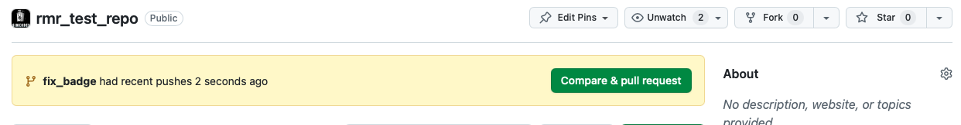
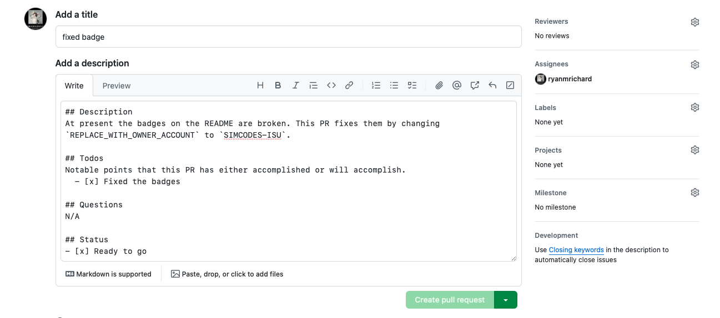
Step 5: Make a PR
Your GitHub repo should display a “Compare & pull request” button. Click it.
You now need to fill out the next page.
The description tells people what you did (and plan to do).
Reviewers is used to pick who will review your PR (pick ryanmrichard)
Assignees is yourself (click ”assign yourself”).
Ignore the rest for now and click “Create pull request”.
This is only done once per branch.
If you have more changes, go back to step 2.

Slide 40
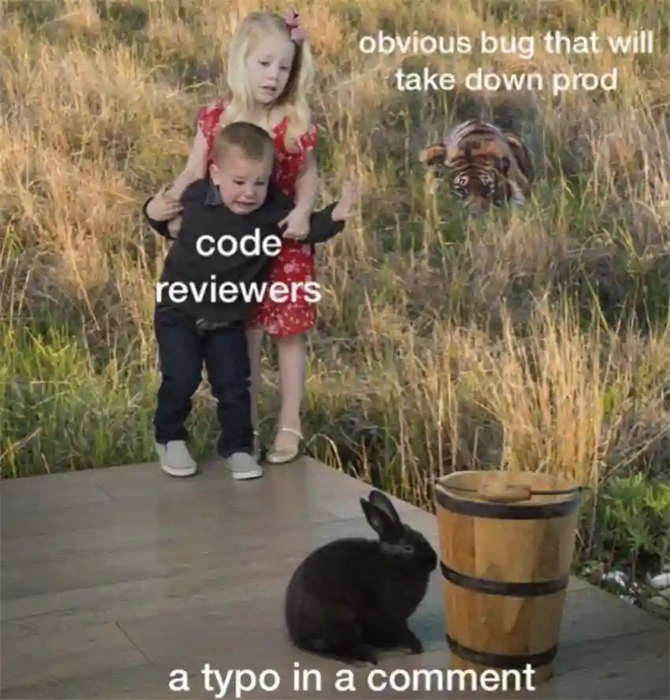
Step 6: Code Review
The goal is to get our changes into the main branch of the remote repo. Merging the PR accomplishes this.
During a code review the maintainers of the remote repo’s main branch decide if your changes can/should be merged or not.
Code review usually involves automated and human checks.
Automated checks run your changes and see if they work.
Reviewers will also look over your changes and may request changes.
If you pass code review, the maintainers will merge your PR.
If you do not pass code review, you go back to Step 2 to make the requested changes.

Slide 41
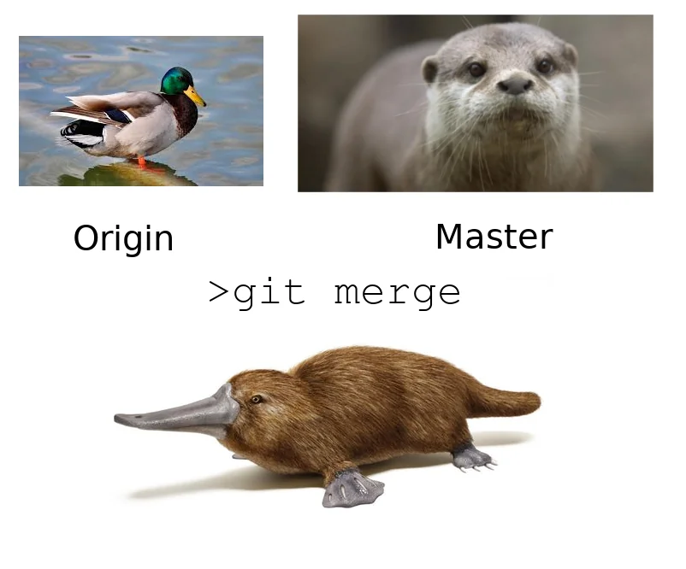
Step 7: Resetting
When your PR is merged the main branch of the remote repo is updated.
Before you can make additional changes, we need to reset.
You should NOT continue to keep making changes to the branch that was merged!
Resetting is another often skipped step.
First, we switch back to main: git checkout main
Pop quiz: How can we determine what branch we’re on?

Slide 42
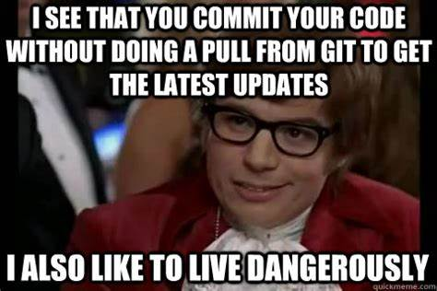
Step 7: Resetting Cont.
Answer: “git status”.
At this point, the local main branch is behind the remote main branch.
“Behind” means the remote branch has all the commits your local branch has and more.
Your local main branch is missing the commits from your PR.
If you run “git status”, ignore “Your branch is up to date with ‘origin/main’”, believe it or not, that doesn’t mean what you think it means…
To update local/main run: git pull origin main
If you encounter an error in this process, you probably ignored me and made changes directly to the main branch…
Running this command when you are up to date with the remote main branch is fine and will do nothing.
Return to Step 1.

Slide 43
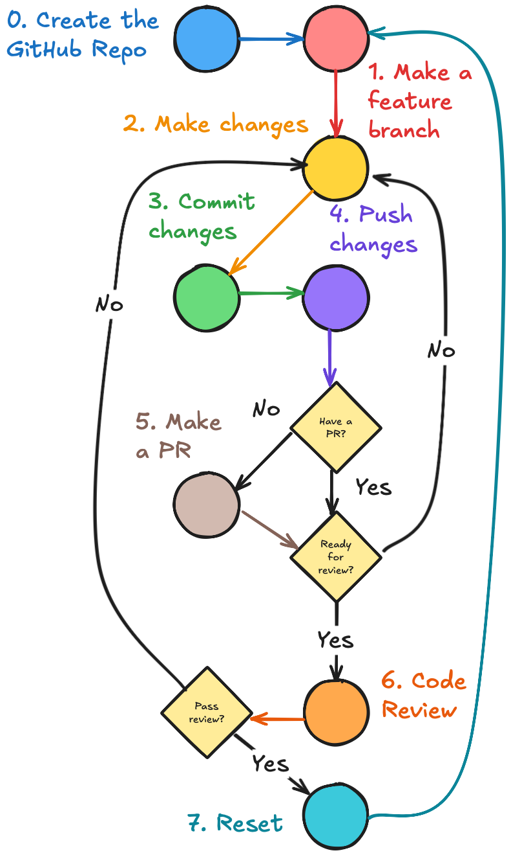
Summary
I strongly recommend following the suggested workflow every single time you make changes!
While intimidating at first, once it’s second nature this workflow adds very little time.
This workflow can scale to simultaneous development of multiple features.
I strongly suggest sticking with a single feature when you first start out.
I would only start to deviate from this workflow when you are comfortable managing multiple branches across multiple remote repositories.
Even then, NEVER skip steps 1 and 7!!!

Slide 44
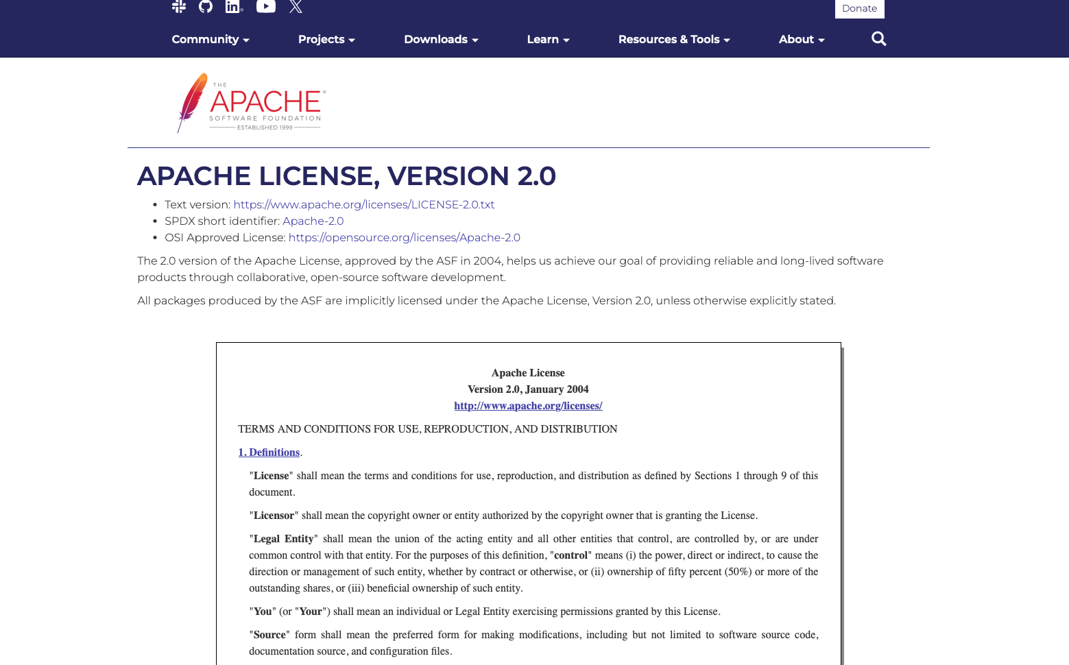
Bonus practice: License File
We mentioned that our repos will be licensed under the Apache 2.0 license, but it wasn’t a choice.
Practice what you learned by creating a file “LICENSE” that lives in the root of your repository.
(In file system lingo “root” refers to the top directory).
The contents of the Apache 2.0 LICENSE can be obtained from: https://www.apache.org/licenses/LICENSE-2.0
Copy/paste the contents of the box into the file.
Create a PR with me tagged as the reviewer when you’re ready.

Slide 45
FAQs
How often should I commit?
This is personal preference. I’d argue best practice is once per “task.” If you do one commit per per task (and your commit messages describe those tasks well), then your PR writes itself in that it’s your commit log.
When should I make a PR?
I recommend making a PR as soon as you push to GitHub. When you’re first starting to develop this makes it easier for others to monitor your progress. When you’re more experienced, it helps others know what you’re working on.
What’s the other stuff on GitHub we skipped over?
GitHub is designed to be a one-stop-shop for software development. It has a lot of features. Most of the other features fall under software engineering and DevOps. Other tutorials will cover some software engineering, but DevOps is beyond this bootcamp.

Slide 46
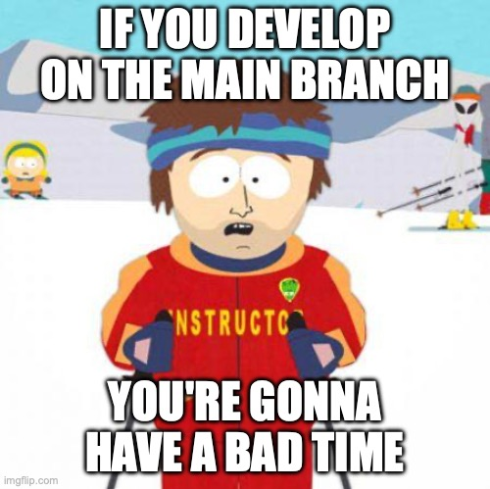
Summary
Collaborating on multiple files with multiple people is difficult.
Version control (VC) makes the process much less painful.
We use Git for VC and GitHub for storing our repos.
Software development follows the same workflow every time.
Deviating from the workflow will increase the likelihood of conflicts, or other problems, arising from when you try to pull or push.

Slide 47

Acknowledgements
MolSSI’s git tutorials https://education.molssi.org/python-package-best-practices/02-git.html
MolSSI’s GitHub tutorials.
NSF for funding SIMCODES.

